Slide 1


Cold Regions Construction Storm Water and Erosion Control
Darrel Williams

Slide 2

Rural Planning Efforts
Based on cold climates storm water and erosion controls
Based on
Needs
Funding used on the project
Determines the framework of construction efforts
  Standards
  Costs
  Timeframes

Slide 3

What is expected for controls in terms of sustainable ?
Project life span/life cycle
Maintenance schedule
Costs
Owners idea of adequate controls
Communities, corporations, or agencies
Usually determined through a funding agreement and contract
Planning
Maintenance
Construction

Slide 4
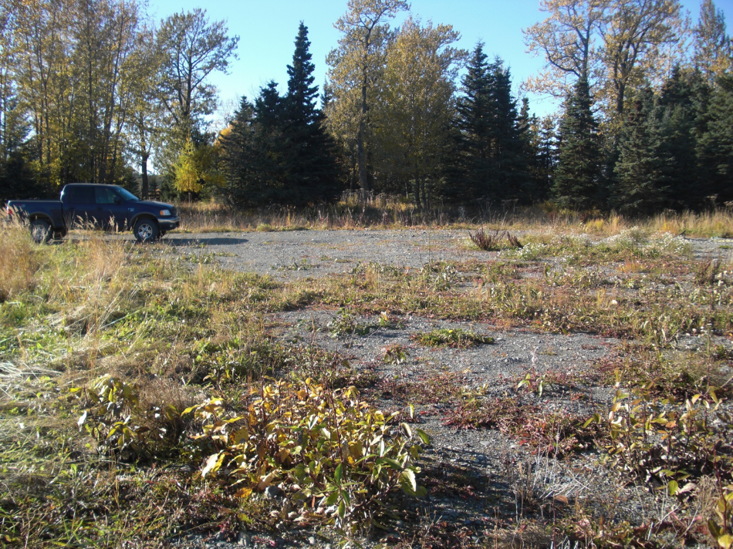
local infrastructure
Most rural places are not very developed
Challenges to planning a project and performing construction

Slide 5
Address some of these issues
Through site reviews
RFP and proposal development
Appropriate details in a bid package

Slide 6
Goals for storm water and erosion controls
Reduction in long term risk
The application of rated capacity (100 year flood or FHWA culvert assessment)
Identified maintenance costs
“Reasonable” project lifespan
The soil erosion and sediment controls should:
  Prevent offsite water from flowing across work areas
  Slow or divert water flowing across the site
  Remove sediments by slowing flow

Slide 7
Cold environments present some additional challenges
Dynamic freeze and thaw process
Changes in the rates of infiltration
The accumulation of pollutants and sediments during low flow conditions

Slide 8
Storm Water Considerations
SWPPP (Storm Water Pollution Prevention Plan)
Projects over 1 acre
required CGP
Site Assessment
  Soils (soil stability)
  Topographic review (how much water are we talking about – how steep is it?)
Temporary or permanent structures
Development of the plan (best practices)

Slide 9
Perimeters, berms, and trenches
  Straw bale barriers and rolls of containment boom
  Or permanent check dams
The direction of flow
Reduction of velocity (sedimentation)
Distribution of the water (infiltration)
Caltrans Storm Water Quality Handbooks (2013)

Slide 10
Use and rural considerations
Consider local knowledge
  How is it going to be used
  When is it going to be used
  Local community efforts
Permitting
Depends on the size and location of the project

Slide 11
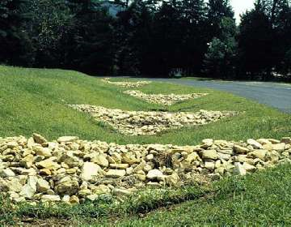
Cold Weather Erosion Controls
Permanent and temporary controls
  85% Vegetation
  Armoring (mats and riprap)
  Bioretention (rain gardens)
  Mulch covers (straw, pulp, mats)
  Dormant seeding
River Link Initiative 2016

Slide 12
Soils and choices of vegetation
Preserving native vegetation
Harvesting / Preserving Native Sod (short holding times)
Stabilization and growth season (Hydro seeding)

Slide 13
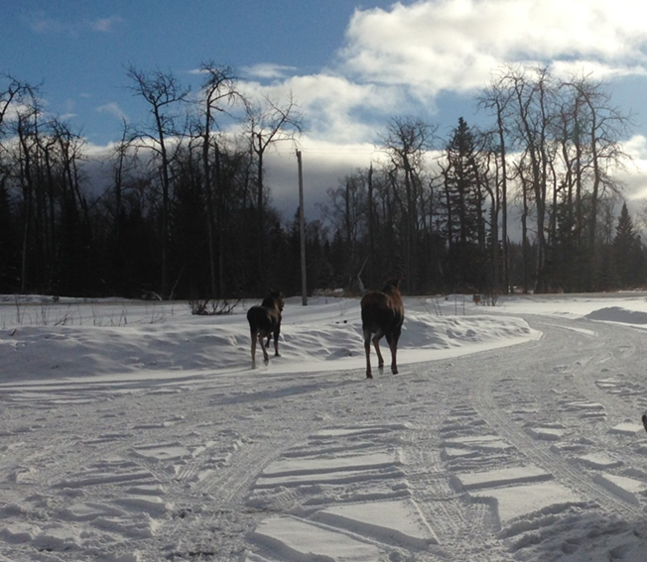
Snow removal
  Part of controlling the water
  The barriers, snow cover, soils, and thaw event
  All contribute to how well the erosion controls will work
Freezing
  Heaving
  Jacking
  Ice Lenses
Permafrost and discontinuous permafrost considerations
  Frost inducement measures, such as snow packing
  Concerns about temperature changes

Slide 14
Questions & Discussion

